Slide 1
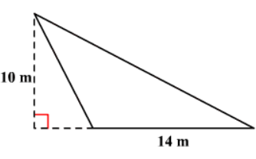
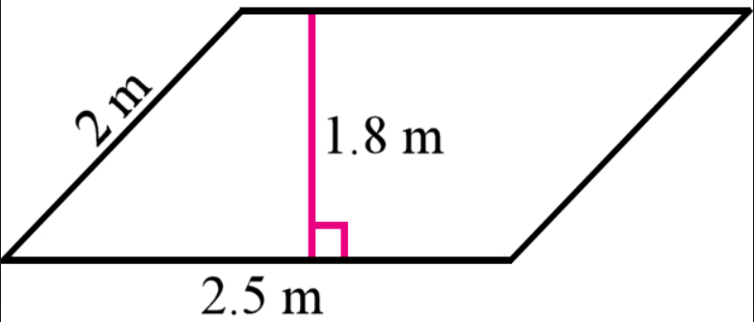
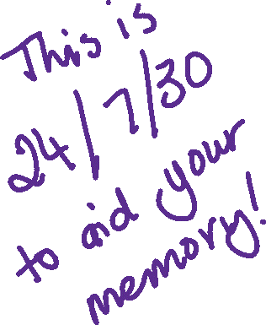
5 Questions
How do I find the area of
Find the area of
Write 110 using prime factorisation
What is 10% of $100?
Given the area of a parallelogram is 28m² and one of the edges is 7m long, find a perpendicular distance between two of the sides.

Slide 2




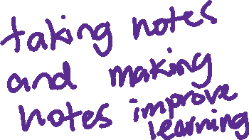





EQ: How do I solve problems involving Area and Perimeter
Number problems
Measurement problems
Example 1
  15$=3×?$
Example 2
  24$=6+6+?+?$
If the area of a rectangle is 15 and one side length is 3 what is the other side length?
If the perimeter of a rectangle is ___ and one side length is ___, what are the other side lengths?

Slide 3











How about triangles?
The area of a triangle 12cm² and the perpendicular height is 4cm what length must the base be?
Steps
Complete each step over here
1.Draw a picture
2. Make up a formula
Put the information you have been given into the formula
Work out the missing information

Slide 4
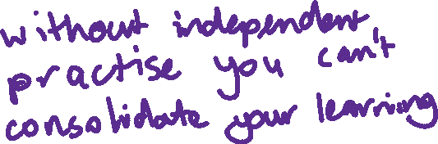
Questions for you to try
Find the side length of a parallelogram if it has a perimeter of 15cm and a side length of 2cm
If the area of a triangle is 10m² and the base is 2m how tall must the triangle be in metres?

Slide 5

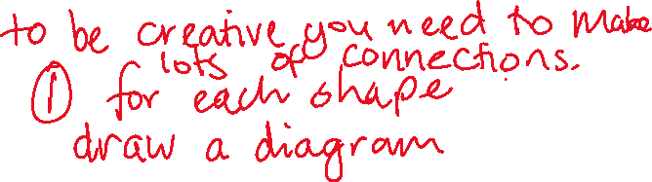















Inquiry
Bunnings have donated 6 square metres of tiles and you need to make a triangle with them you can cut the tiles any way you like but you must have a triangular shape at the end.
Create 2 different size rectangles each being an area of 6 square metres and create 2 different triangles also each with an area of 6square metres.
Create a poster that show these explaining how you have done this

Slide 6
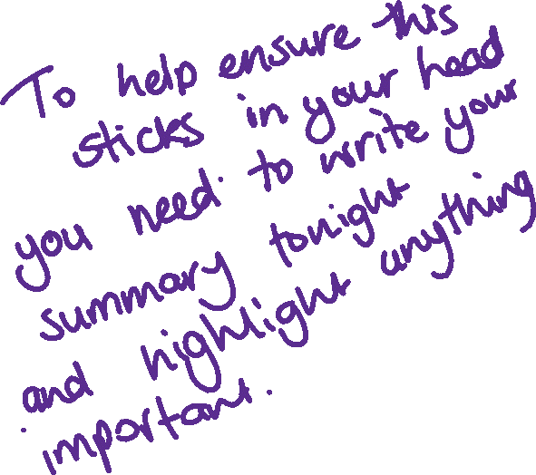
Conclusion
What are the important steps required to complete each of your posters. I’ll ask people to share.

